Slide 1





C programming project
Project Name : Library Management System
Github link :https://github.com/sayan1812/Library_management_system.git
name : AL Aziz
Sec : A
Roll no: 84

Slide 2
Variables:
1.Book ID - A unique identifier assigned to each book in the library
Title - The title of the book
Author - The author(s) of the book
Publisher - The publishing company that produced the book
ISBN - The International Standard Book Number assigned to the book
Publication year - The year the book was published
Category/genre - The type or category of book (e.g. fiction, non-fiction, mystery, etc.)
Availability - Indicates whether the book is available for borrowing or currently checked out
Borrower ID - The unique identifier assigned to a library patron who has checked out a book
Due date - The date by which the borrowed book must be returned to the library.

Slide 3
Functions:
Cataloguing - Adding new books to the library's collection by creating records of books with details such as author, title, publisher, ISBN, and other relevant information.
Circulation - Managing the borrowing and returning of books, tracking loan periods, and sending reminders for overdue books.
Reservation - Allowing patrons to reserve books that are currently checked out, and notifying them when the book is available for pickup.
Reporting - Generating reports on the usage of the library collection, such as circulation statistics, overdue books, popular books, and other relevant metrics.
User management - Managing the profiles of library users, including creating new user accounts, updating user information, and managing user privileges.
Catalog search - Allowing patrons to search the library catalog to find books by author, title, subject, or keyword.
Fine management - Managing the calculation and collection of fines for overdue books, and maintaining records of fines paid by patrons.
Security - Implementing security measures to protect the library's collection, including monitoring book movements and detecting potential theft.

Slide 4
Files :
1. Book ID - A unique identifier assigned to each book in the library.
Title - The title of the book.
Author - The author(s) of the book.
Publisher - The publishing company that produced the book.
Price - The cost of acquiring the book.
Publication year - The year the book was published.
Category/genre - The type or category of book (e.g. fiction, non-fiction, mystery, etc.).
Library branch - The location of the library branch where the book is located.
Borrower ID - The unique identifier assigned to a library patron who has checked out a book.
Due date - The date by which the borrowed book must be returned to the library.
Patron ID - A unique identifier assigned to each library patron.
Name - The name of the patron.
Address - The address of the patron.
.

Slide 5
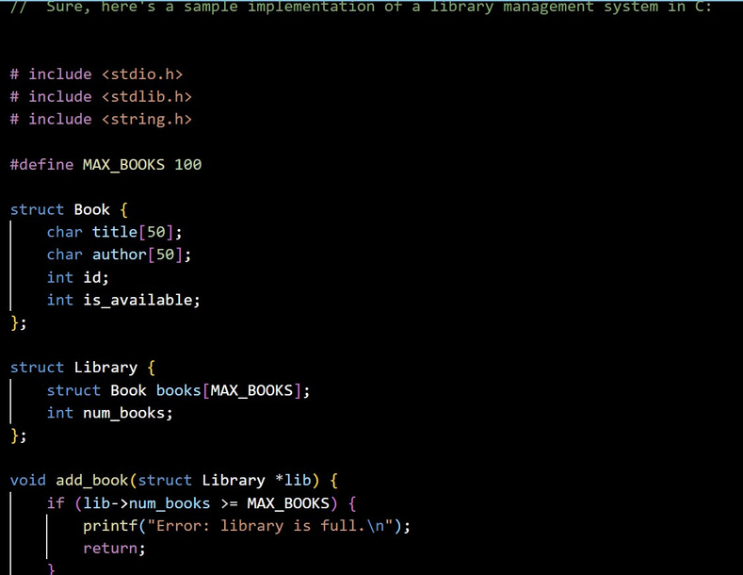
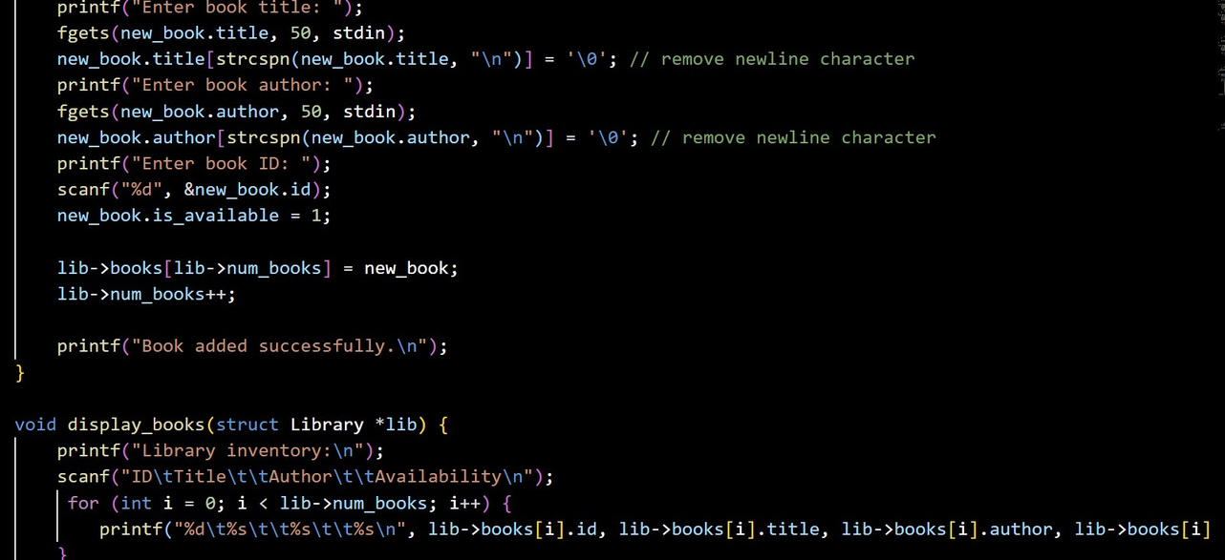
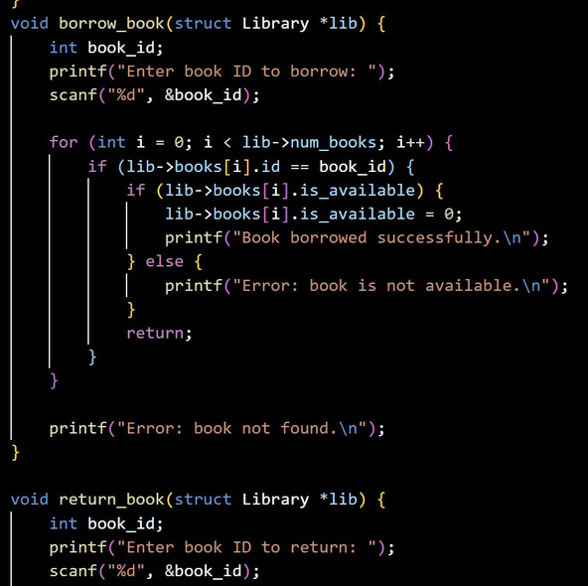
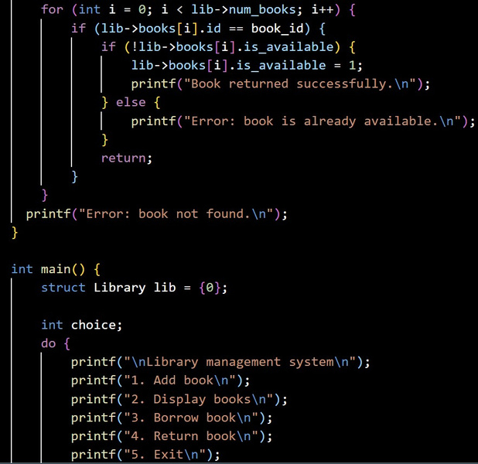
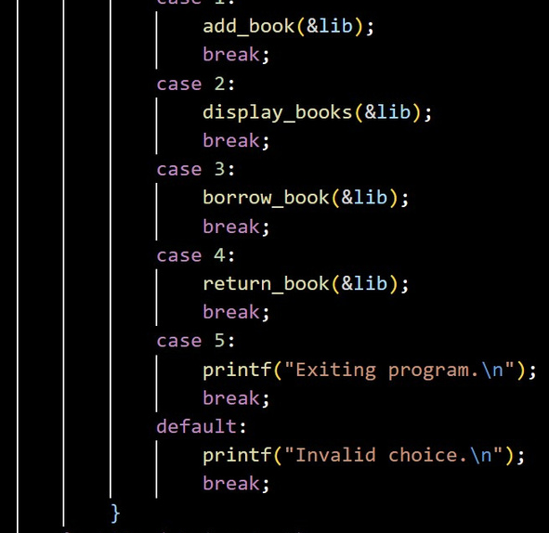
Screenshots :

Slide 6


